Slide 1
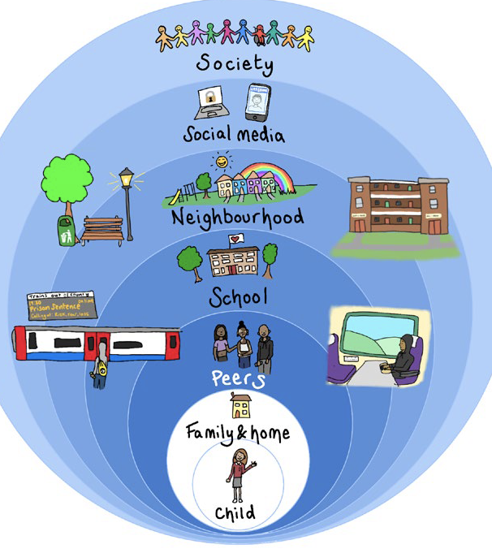
What contexts do we exist in?
What is the young person’s experience in each context?
Where do their most important relationships exist?
How can we identify strengths & opportunities, as well as risks & harm in each context?

Slide 2
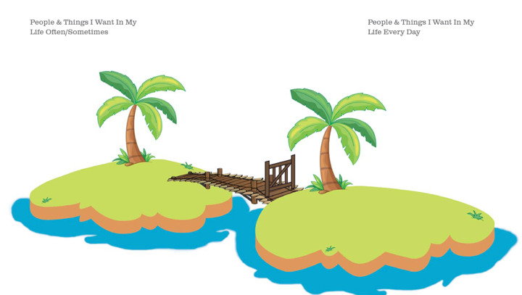
Island Activity

Slide 3
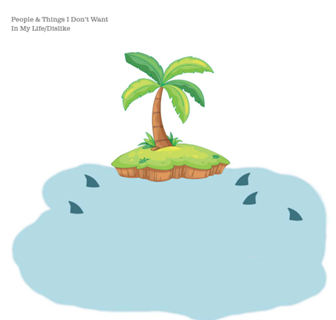
Island Activity

Slide 4
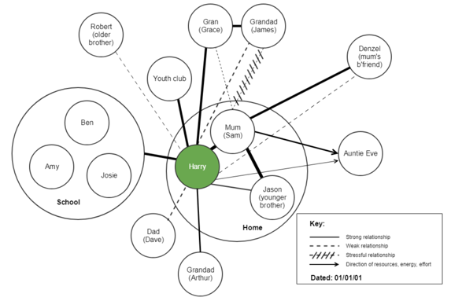
How can we map the significant relationships & contexts for a young person?
Unlike genograms which are very structured and show the make-up of a young person’s family, ecomaps are a visual means of a young person showing who is in their network (be that family, friends, neighbours, school staff) and what sort of relationships they have with them. Developing an ecomap with a child or young person can identify the context in which they live, who they feel aligned to, or if they are isolated in certain areas.

Slide 5
How can we map the significant relationships & contexts for a young person?
Example ecomap: “Harry”, represented by the green circle in the middle of the image. Through working with him you have developed the following ecomap.
Note: This image is computer generated to allow ease of reading across devices – ecomaps are often best done when hand drawn by the individual concerned.

Slide 6
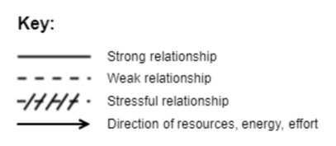
How can we map the significant relationships & contexts for a young person?
Top tips:
Always use a large sheet of paper and ensure that the child / young person is in the centre of the paper.
Use cut out shapes which can be moved around as needed before the final version is stuck down.
The strength of relationships can be illustrated however the young person feels they want to do it. It is however important that there is a key so that the ecomap can be understood.
Date the ecomap – things change!
Use colour & encourage the young person’s creativity & ownership of the document.

Slide 7
How can I use an ecomap to understand a young person’s relationships and contexts?

Slide 8
How can we build safety for young people, their peers and the locations they spend time in?
How can we safety map with young people?
How can we plan & build safety with young people, parents, carers & professionals?
How can we respond to abuse from image sharing?

Slide 9
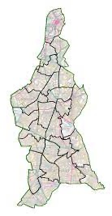
How can I safety map with a young person?
Find out where the young person spends time
Print out a large map of London/Lambeth and any other locations
Use a traffic light system to identify areas of safety and concern
Use this information to safety plan with the young person
Unsafe
Could be safe
Safe

Slide 10
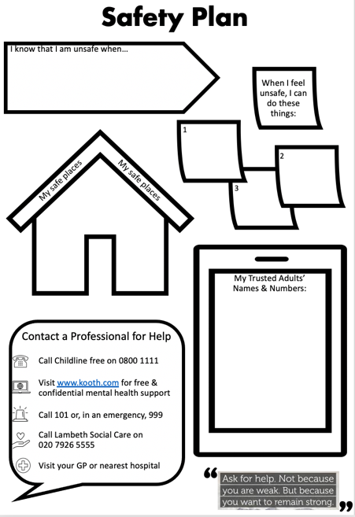
How can I work with a young person to create a safety plan?
Young people are not responsible for their own exploitation.
The Safety Plan does not put all the action & expectation on the young person to ‘keep themselves safe’. Instead, it is a practical tool the young person can rely on when they don’t feel safe.

